Slide 1
CSS
CSS stands for Cascading Style Sheets
CSS describes how HTML elements are to be displayed on screen, paper, or in other media
CSS saves a lot of work. It can control the layout of multiple web pages all at once
External stylesheets are stored in CSS files

Slide 2

CSS Syntax and Selectors
CSS Syntax
A CSS rule-set consists of a selector and a declaration block:
The selector points to the HTML element you want to style
.
The declaration block contains one or more declarations separated by semicolons.
Each declaration includes a CSS property name and a value, separated by a colon.
A CSS declaration always ends with a semicolon, and declaration blocks are surrounded by curly braces.

Slide 3
In the following example all <p> elements will be center-aligned, with a red text color:
p {
color: red;
text-align: center;
}

Slide 4
CSS Selectors
CSS selectors are used to "find" (or select) HTML elements based on their element name, id, class, attribute, and more.
The element Selector
The element selector selects elements based on the element name.
You can select all <p> elements on a page like this (in this case, all <p> elements will be center-aligned, with a red text color):
p {
text-align: center;
color: red;
}

Slide 5
The id Selector
The id selector uses the id attribute of an HTML element to select a specific element.
The id of an element should be unique within a page, so the id selector is used to select one unique element!
To select an element with a specific id, write a hash (#) character, followed by the id of the element.
The style rule below will be applied to the HTML element with id="para1":

Slide 6
Example
#para1 {
text-align: center;
color: red;
}
Note: An id name cannot start with a number!

Slide 7
The class Selector
The class selector selects elements with a specific class attribute.
To select elements with a specific class, write a period (.) character, followed by the name of the class.
In the example below, all HTML elements with class="center" will be red and center-aligned:

Slide 8
Example
.center {
text-align: center;
color: red;
}

Slide 9
Grouping Selectors
If you have elements with the same style definitions, like this:
h1 {
text-align: center;
color: red;
}
h2 {
text-align: center;
color: red;
}
p {
text-align: center;
color: red;
}

Slide 10
It will be better to group the selectors, to minimize the code.
To group selectors, separate each selector with a comma.
In the example below we have grouped the selectors from the code above:
Example
h1, h2, p {
text-align: center;
color: red;
}

Slide 11
Three Ways to Insert CSS
External style sheet
Internal style sheet
Inline style

Slide 12
External CSS
With an external style sheet, you can change the look of an entire website by changing just one file!
Each page must include a reference to the external style sheet file inside the <link> element. The <link> element goes inside the <head> section:

Slide 13
Example
<head>
<link rel="stylesheet" type="text/css" href="mystyle.css">
</head>
An external style sheet can be written in any text editor. The file should not contain any html tags. The style sheet file must be saved with a .css extension.
Here is how the "mystyle.css" looks:

Slide 14
body {
background-color: lightblue;
}
h1 {
color: navy;
margin-left: 20px;
}

Slide 15
Internal Style Sheet
An internal style sheet may be used if one single page has a unique style.
Internal styles are defined within the <style> element, inside the <head> section of an HTML page:

Slide 16
Example
<head>
<style>
body {
background-color: linen;
}
h1 {
color: maroon;
margin-left: 40px;
}
</style>
</head>

Slide 17
Inline Styles
An inline style may be used to apply a unique style for a single element.
To use inline styles, add the style attribute to the relevant element. The style attribute can contain any CSS property.
The example below shows how to change the color and the left margin of a <h1> element:
<h1 style="color:blue;margin-left:30px;">This is a heading</h1>

Slide 18
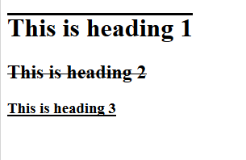
Text Properties
Text-decoration:none;
overline;
underline;
line-through;

Slide 19
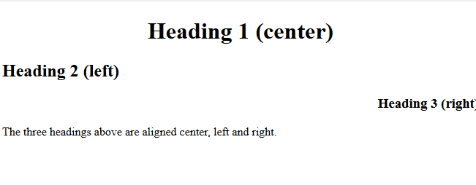
Text-align:center;
:left;
:right;
:justify;

Slide 20
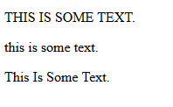
Text-transform:uppercase;
:lowercase;
:capitalize;

Slide 21
Text Indentation
The text-indent property is used to specify the indentation of the first line of a text:
Example
p {
text-indent: 50px;
}

Slide 22
Text Shadow
The text-shadow property adds shadow to text.
The following example specifies the position of the horizontal shadow (3px), the position of the vertical shadow (2px) and the color of the shadow (red):
h1 {
text-shadow: 3px 2px red;
}

Slide 23
Letter Spacing
The letter-spacing property is used to specify the space between the characters in a text.
The following example demonstrates how to increase or decrease the space between characters:

Slide 24
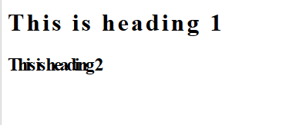
<!DOCTYPE html>
<html>
<head>
<style>
h1 {
letter-spacing: 3px;
}
h2 {
letter-spacing: -3px;
}
</style>
</head>
<body>
<h1>This is heading 1</h1>
<h2>This is heading 2</h2>
</body>
</html>

Slide 25
Line Height
The line-height property is used to specify the space between lines:

Slide 26
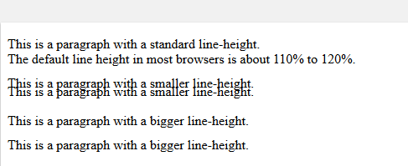
<head>
<style>
p.small {
line-height: 0.6;
}
p.big {
line-height: 1.8;
}
</style>
</head>
<body>
<p>
This is a paragraph with a standard line-height.<br>
The default line height in most browsers is about 110% to 120%.<br>
</p>
<p class="small">
This is a paragraph with a smaller line-height.<br>
This is a paragraph with a smaller line-height.<br>
</p>
<p class="big">
This is a paragraph with a bigger line-height.<br>
This is a paragraph with a bigger line-height.<br>
</p>
</body>

Slide 27
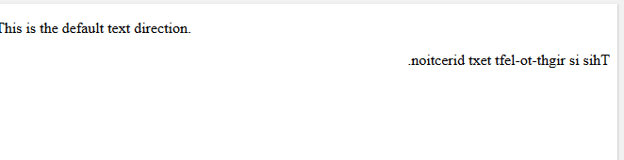
Text Direction
The direction property is used to change the text direction of an element:

Slide 28
<!DOCTYPE html>
<html>
<head>
<style>
p.ex1 {
direction: rtl;
}
</style>
</head>
<body>
<p>This is the default text direction.</p>
<p class="ex1"><bdo dir="rtl">This is right-to-left text direction.</bdo></p>
</body>
</html>

Slide 29
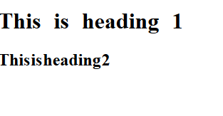
Word Spacing
The word-spacing property is used to specify the space between the words in a text.
The following example demonstrates how to increase or decrease the space between words:

Slide 30
<!DOCTYPE html>
<html>
<head>
<style>
h1 {
word-spacing: 10px;
}
h2 {
word-spacing: -5px;
}
</style>
</head>
<body>
<h1>This is heading 1</h1>
<h2>This is heading 2</h2>
</body>
</html>

Slide 31
Font Family
The font family of a text is set with the font-family property.
The font-family property should hold several font names as a "fallback" system. If the browser does not support the first font, it tries the next font, and so on.
Start with the font you want, and end with a generic family, to let the browser pick a similar font in the generic family, if no other fonts are available.
Note: If the name of a font family is more than one word, it must be in quotation marks, like: "Times New Roman".
More than one font family is specified in a comma-separated list:

Slide 32
p {
font-family: "Times New Roman", Times, serif;
}

Slide 33
Font Style
The font-style property is mostly used to specify italic text.
This property has three values:
normal - The text is shown normally
italic - The text is shown in italics
oblique - The text is "leaning" (oblique is very similar to italic, but less supported)

Slide 34
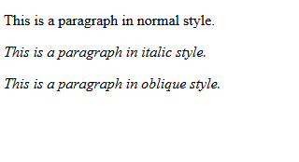

Slide 35
Font-size

Slide 36
Font weight
The font-weight property specifies the weight of a font:

Slide 37
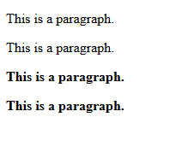
<head>
<style>
p.normal {
font-weight: normal;
}
p.light {
font-weight: lighter;
}
p.thick {
font-weight: bold;
}
p.thicker {
font-weight: 900;
}
</style>
</head>
<body>
<p class="normal">This is a paragraph.</p>
<p class="light">This is a paragraph.</p>
<p class="thick">This is a paragraph.</p>
<p class="thicker">This is a paragraph.</p>
</body>
</html>

Slide 38
Font Variant
The font-variant property specifies whether or not a text should be displayed in a small-caps font.
In a small-caps font, all lowercase letters are converted to uppercase letters. However, the converted uppercase letters appears in a smaller font size than the original uppercase letters in the text.

Slide 39
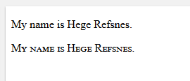
<!DOCTYPE html>
<html>
<head>
<style>
p.normal {
font-variant: normal;
}
p.small {
font-variant: small-caps;
}
</style>
</head>
<body>
<p class="normal">My name is Hege Refsnes.</p>
<p class="small">My name is Hege Refsnes.</p>
</body>
</html>

Slide 40
CSS Backgrounds
The CSS background properties are used to define the background effects for elements.
CSS background properties:
background-color
background-image
background-repeat
background-attachment
background-position

Slide 41


Slide 42
Border Style
The border-style property specifies what kind of border to display.
The following values are allowed:
dotted - Defines a dotted border
dashed - Defines a dashed border
solid - Defines a solid border
double - Defines a double border
groove - Defines a 3D grooved border. The effect depends on the border-color value
ridge - Defines a 3D ridged border. The effect depends on the border-color value
inset - Defines a 3D inset border. The effect depends on the border-color value
outset - Defines a 3D outset border. The effect depends on the border-color value
none - Defines no border
hidden - Defines a hidden border

Slide 43
Border Width
The border-width property specifies the width of the four borders.
The width can be set as a specific size (in px, pt, cm, em, etc) or by using one of the three pre-defined values: thin, medium, or thick.
The border-width property can have from one to four values (for the top border, right border, bottom border, and the left border).

Slide 44
Border Color
The border-color property is used to set the color of the four borders.
The border-color property can have from one to four values (for the top border, right border, bottom border, and the left border).

Slide 45
Rounded Borders
The border-radius property is used to add rounded borders to an element:

Slide 46
border
Border-size:80px;
Border:size type color;
Border-radius:30px;
Border-top-left-radius:40px;
Border-bottom-left-radius:40px;
Box-shadow:20px 30px pink;
Box-shadow:20px 30px 30px pink;

Slide 47
CSS padding properties are used to generate space around an element content inside of any defined borders.
CSS margin properties are used to create space around elements outside of any defined borders.

Slide 48
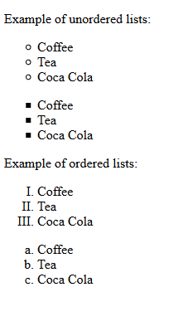
list-style-type
<!DOCTYPE html>
<html>
<head>
<style>
ul.a {
list-style-type: circle;
}
ul.b {
list-style-type: square;
}
ol.c {
list-style-type: upper-roman;
}
ol.d {
list-style-type: lower-alpha;
}
</style>
</head>

Slide 49
list-style-image

Slide 50
list-style-position

Slide 51
Remove Default Settings
The list-style-type:none property can also be used to remove the markers/bullets. Note that the list also has default margin and padding. To remove this, add margin:0 and padding:0 to <ul> or <ol>:

Slide 52
Table properties
Width:20px;
Height:50px;
text-align: left;
vertical-align: bottom; (like top, bottom, or middle)
border: 1px solid black;
border-collapse: collapse;
The border-collapse property sets whether the table borders should be collapsed into a single border:

Slide 53
padding: 15px;
To control the space between the border and the content in a table, use the padding property on <td> and <th> elements:
border-bottom: 1px solid #ddd;

Slide 54
Block-level Elements
A block-level element always starts on a new line and takes up the full width available (stretches out to the left and right as far as it can).
Examples of block-level elements:
<div>
<h1> - <h6>
<p>
<form>
<header>
<footer>
<section>

Slide 55
Inline Elements
An inline element does not start on a new line and only takes up as much width as necessary.
This is an inline <span> element inside a paragraph.
Examples of inline elements:
<span>
<a>
<img>

Slide 56
Anchor Properties
Selector | Description | Example
a:link | sets the style for an unvisited link | a:link {font-family:Arial; color:red; text-decoration:none}
a:visited | sets the style for a visited link | a:visited {font-family:Arial; color:green; text-decoration:none}
a:active | sets the style for the link when it is linking
a:hover | sets the style for the link while the mouse pointer is hovering over the text | a:hover {font-family:Arial; color:black; text-decoration:none}

Slide 57
Properties For Image
opacity: 0.5;
filter: alpha(opacity=50); /* For IE8 and earlier */
The opacity property can take a value from 0.0 - 1.0. The lower value, the more transparent

